Slide 1
FILE HANDLING
Unit 6

Slide 2

File??
A file represents a sequence of bytes on the disk where a group of related data is stored. File is created for permanent storage of data. It is a ready made structure.
In C language, we use a structure pointer of file type to declare a file.

Slide 3
Types of Files
When dealing with files, there are two types of files you should know about:
Text files
Binary files
1. Text files
Text files are the normal .txt files that you can easily create using Notepad or any simple text editors.
When you open those files, you'll see all the contents within the file as plain text. You can easily edit or delete the contents.
They take minimum effort to maintain, are easily readable, and provide least security and takes bigger storage space.
2. Binary files
Binary files are mostly the .bin files in your computer.
Instead of storing data in plain text, they store it in the binary form (0's and 1's).
They can hold higher amount of data, are not readable easily and provides a better security than text files.

Slide 4
File Operations
In C, you can perform four major operations on the file, either text or binary:
Creating a new file
Opening an existing file
Closing a file
Reading from and writing information to a file

Slide 5
Opening a File or Creating a File
The fopen() function is used to create a new file or to open an existing file.
Syntax::
#include <stdio.h>
void main()
{
FILE *fp;
fp = fopen("filename", "mode");
}
*fr is the FILE pointer, which will hold the reference to the opened(or created) file.
filename is the name of the file to be opened and mode specifies the purpose of opening the file.

Slide 6
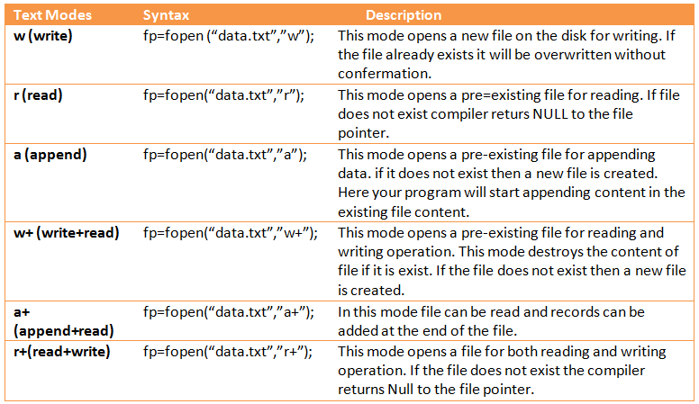
File Modes

Slide 7
Closing a File
The fclose() function is used to close an already opened file.
#include <stdio.h>
void main()
{ FILE *fp;
fclose(fp);
}
fclose() function closes the file and returns zero on success, or non-zero if there is an error in closing the file.

Slide 8
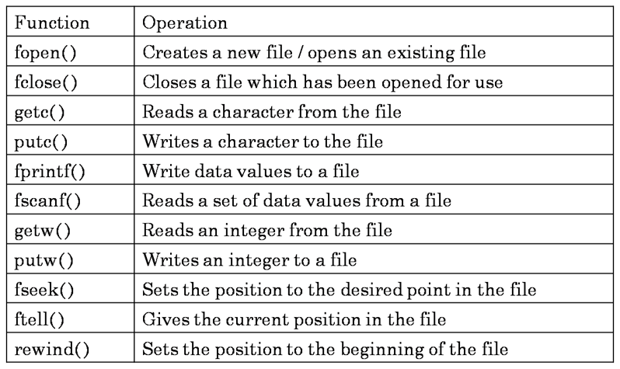

Slide 9
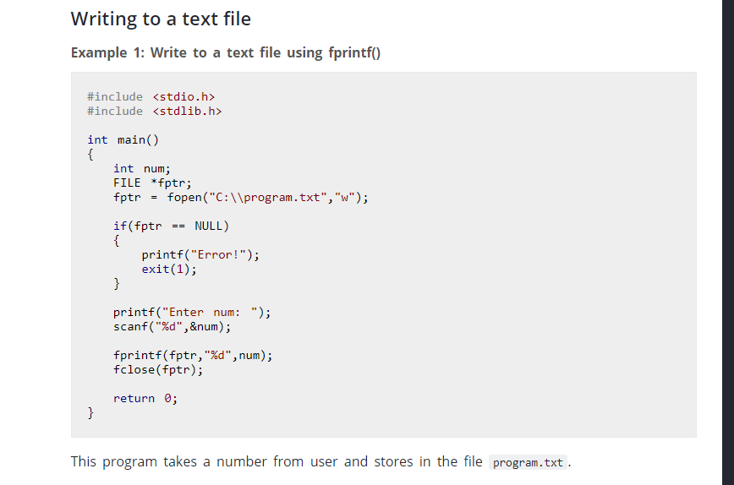
Writing formatted data

Slide 10
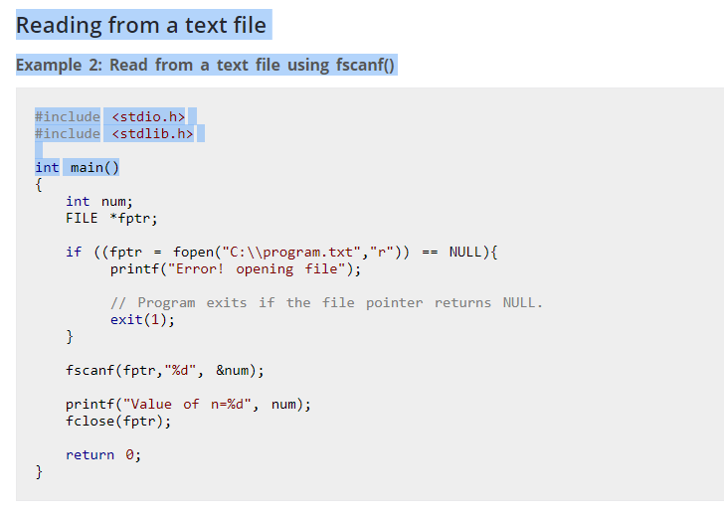
Reading formatted text

Slide 11
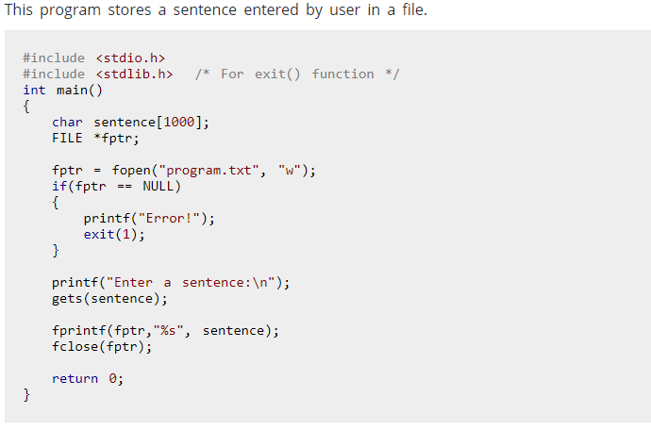

Slide 12
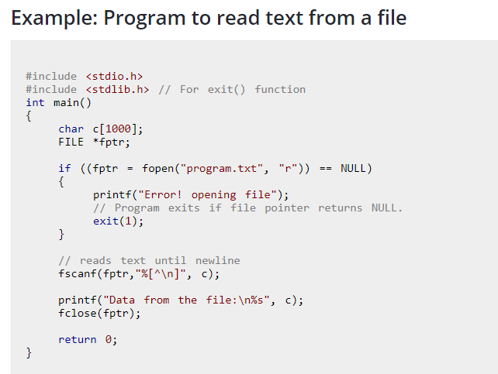
Reading a line

Slide 13
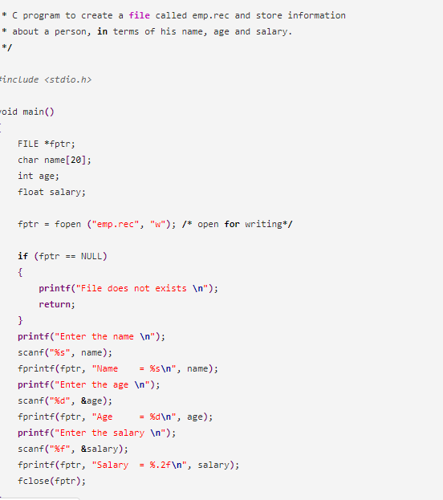

Slide 14
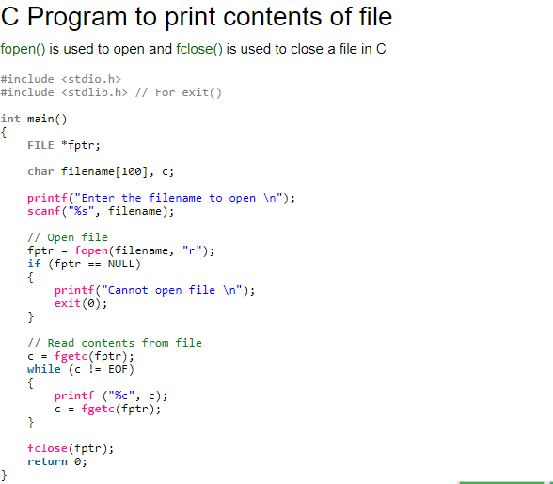
Read char by char

Slide 15
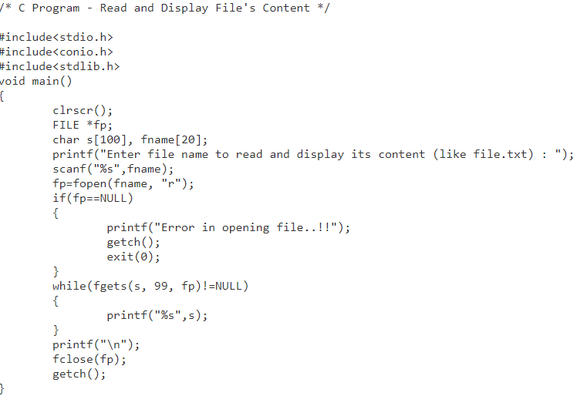
Read line by line

